Slide 1

Intrusion Detection System in Mobile Phone Systems Using Deep Belief Network (DBN)
MLA0403 – Deep Learning
Students Names
Kothakota Rakesh
Shaik Rafiqhuddin
M Akash A Santhosh
SIMATS Engineering
Guided By
Dr.A.M.Arul Raj
Professor
SIMATS Engineering
Notes:
1
1

Slide 2
Abstract
Mobile devices are increasingly targeted by cyber attacks.
A Deep Belief Network (DBN) learns patterns from network traffic.
The system detects malicious activities with high accuracy.
Improves mobile network security through intelligent intrusion detection.

Slide 3
Aim and Objective
To develop an intelligent Intrusion Detection System (IDS) for mobile phone networks using a Deep Belief Network (DBN).
To improve the accuracy of detecting cyberattacks while reducing false alarms and enhancing mobile network security.
Collect and preprocess mobile network traffic data for model training.
Train a Deep Belief Network (DBN) to distinguish between normal and malicious network behaviour.
Detect and classify different types of network intrusions with high accuracy and low false alarm rates.
Generate real-time security alerts to help protect mobile devices and networks from cyber threats.

Slide 4

Introduction
Mobile phones have become an essential part of daily life, making them a common target for cyber attacks such as malware, phishing, and unauthorized access.
Traditional intrusion detection systems often fail to detect new and sophisticated attacks due to their reliance on predefined signatures.
Deep Learning techniques, especially Deep Belief Networks (DBN), can automatically learn complex patterns from network traffic and identify both known and unknown intrusions.
This project proposes a DBN-based Intrusion Detection System to improve the accuracy, efficiency, and reliability of mobile network security through intelligent attack detection.

Slide 5
Literature Review & Requirement Analysis
S.No | Year of Publication | Author | Title of the Journal / book | Methodology used | Algorithm used | Key Findings
1 | 2021 | Sharma et al. | Mobile Network Intrusion Detection | Deep Learning | CNN | High detection accuracy, reduced false positives
2 | 2022 | Wang et al. | Intelligent IDS for Mobile Networks | Feature Extraction + Classification | DBN | Better detection of unknown attacks
3 | 2023 | Kumar et al. | Deep Learning for Network Security | Data Preprocessing & Training | DBN | Improved accuracy and faster intrusion detection

Slide 6
Problem Statement
Increasing cyber threats targeting mobile phone networks.
Traditional intrusion detection systems have low accuracy against unknown attacks.
Large volumes of network traffic make real-time threat detection difficult.
Need a Deep Belief Network (DBN)-based Intrusion Detection System for accurate, intelligent, and real-time attack detection.

Slide 7
Existing System
Signature-based Intrusion Detection Systems (IDS) are widely used.
Detect only known attacks using predefined attack signatures.
Low detection accuracy for new or zero-day attacks.
High false positive and false negative rates in mobile networks.
Limited real-time analysis and adaptability to evolving cyber threats.

Slide 8
Proposed System
Develop a Deep Belief Network (DBN)-based Intrusion Detection System for mobile phone networks.
Collect and preprocess mobile network traffic for effective feature learning.
Detect and classify known and unknown cyber attacks with high accuracy.
Generate real-time intrusion alerts to enhance network security.
Improve detection performance while reducing false positives and false negatives.

Slide 9
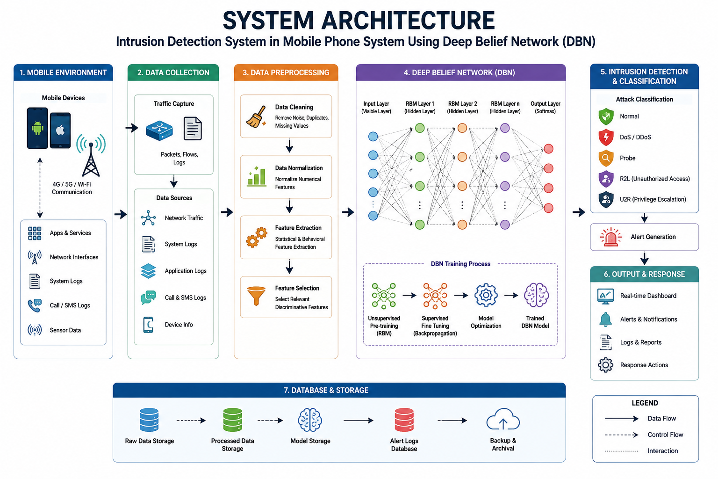

Slide 10


Sustainable Development Goal (SDG) Implementation
SDG 9 – Industry, Innovation and Infrastructure
Why SDG 9?
Your project uses Artificial Intelligence (Deep Learning) to strengthen digital infrastructure and improve cybersecurity in mobile networks.

Slide 11
Proposed Methodology and Algorithm
Methodology
Collect mobile network traffic dataset (e.g., NSL-KDD or CICIDS2017).
Preprocess data by cleaning, normalizing, and selecting relevant features.
Train the Deep Belief Network (DBN) to learn normal and malicious traffic patterns.
Detect and classify intrusions, then generate real-time security alerts.
Algorithm - Deep Belief Network (DBN)

Slide 12
Design & Module Planning
Module 1: Data Collection & Preprocessing
Module 2: Feature Extraction
Module 3: DBN Model Training & Testing
Module 4: Intrusion Detection & Alert Generation

Slide 13
Conclusion
Developed a Deep Belief Network (DBN)-based Intrusion Detection System for mobile phone network security.
Improved detection of both known and unknown cyber attacks through deep learning.
Enhanced network security with real-time intrusion detection and alert generation.
Demonstrated the potential of AI and Deep Learning to provide accurate, reliable, and scalable cybersecurity solutions for mobile networks.

Slide 14
References
Ian Goodfellow, Yoshua Bengio, and Aaron Courville, Deep Learning, MIT Press, Cambridge, Massachusetts, 1st Edition, 2016. Deep Learning fundamentals, Neural Networks, Deep Belief Networks (DBN), model training, and optimization.
Behrouz A. Forouzan, Data Communications and Networking, McGraw-Hill Education, 5th Edition, 2017.Mobile communication networks, network protocols, packet transmission, and network architecture.
Faheem Syeed Masoodi and Alwi Bamhdi (Editors), Deep Learning for Intrusion Detection: Techniques and Applications, John Wiley & Sons, 1st Edition, 2025.Deep Learning, Intrusion Detection Systems (IDS), Wireless Networks, IoT Security, Zero-Day Attack Detection.
Eoffrey E. Hinton, Simon Osindero, and Yee-Whye Teh, A Fast Learning Algorithm for Deep Belief Nets, Neural Computation, Vol. 18, No. 7, 2006, pp. 1527–1554.
Aheem Syeed Masoodi and Alwi Bamhdi (Eds.), Deep Learning for Intrusion Detection: Techniques and Applications, Wiley, 1st Edition, 2025.

Slide 15
THANK YOU!!!

